Slide 1
Research Roundup
A Forum for Administrators of Research and Sponsored Programs

Slide 2
Agenda
Welcome and Introductions
Research Roundup Purpose
Overview of Research Administration
Roles and Responsibilities
Games and Prizes

Slide 3
Welcome and
Introductions

Slide 4
Purpose
Distribute information
Network with peers and colleagues
Training opportunities

Slide 5
Division of Research and Innovation
Office of Sponsored Programs
Research Development
Research Compliance
FedEx Institute
Division of Business and Finance
Grants & Contracts Accounting

Slide 6
Research Compliance
Beverly Jacobik Sr. Associate Director for Research Compliance Financial Conflict of Interest Officer Export Controls Officer Kellie Watson Research Compliance Coordinator IRB Administrator
Karyl Buddington
Director, Animal Care Facilities Donny Ray Manager, Animal Care Facilities
Animal Care Technicians

Slide 7
Office of Sponsored Programs
Heather Winters, Senior Director
Ty Flores,
Sponsored Programs Administrator (SPA)
Stephanie Thompson, Sponsored Programs Administrator (SPA)
Student workers
Angela Fair, Sr. Associate Director
Laura Wright, Sponsored Programs Administrator (SPA)
Leslie Ingram, eRA Coordinator
Lauren Williams, Sponsored Programs Coordinator

Slide 8
Research Development focuses on increasing institutional research competitiveness through targeted capacity building, partnership and interdisciplinary team development, and proposal development assistance activities. This team manages limited competition proposals, large-scale or center proposals, and Career development proposals.
Deborah Hernandez, Director
Portfolio:
Physical Sciences, Engineering, Business; the University's Strategic Research Investment Fund Projects, STEM Doctoral Fellowship Programs, Partnership with the Czech Academy of Sciences, and Research Infrastructure projects.
Vernisa Hazlett, Project Coordinator
Mary Earheart-Brown, Sr. Associate Director
Portfolio:
Education, Humanities, Fine Arts, Social Sciences; Communities of Research Scholars Program (CoRS) and the University's Partnership with the Urban Child Institute.
Francoise Mireles, Research Development Specialist

Slide 9
Grants & Contracts Accounting
Grants and Contracts Accounting is responsible for the review and reporting of all restricted and endowment accounts at the University. This includes grants, contracts, gift accounts, scholarships, Chairs of Excellence, Centers of Excellence, and other restricted activities.

Slide 10
Research Administration
Overseeing all aspects of the grant management cycle
Proposal and budget development
Provide management, support and oversight of research projects and external sponsored funds
Help ensure research goals are achieved
Meet reporting requirements and implement and follow all government, sponsor and university policies and regulations
TEAM approach

Slide 11
Roles/Responsibilities OSP
Proposal Review and Submission
Research Compliance Review and Oversight
JIT (Just in Time) requests
Award Review, Negotiation and Acceptance
Prior Approval Requests
Issue outgoing Subawards
Non-Financial Post Award
Non-Financial Closeout

Slide 12
Roles/Responsibilities Departmental Admins
Proposal and Budget Development
Cayuse
Review and Understand Awards
Assist/Initiate Prior Approval Requests
Review Subaward Invoices
Financial monitoring
Coordinate with others

Slide 13
Roles/Responsibilities PI/Chair/Deans
Proposal Development
Complete and maintain Compliance requirements
Cayuse Certifications
Review and Understand Awards
Certification of expenses, including Subaward Invoices
Programmatic Reports

Slide 14
Proposal Submission – Best Practices
Notification to OSP
What is the deadline?
Internal/external
Prime/flow-through
electronic routing
Minimum requirements

Slide 15
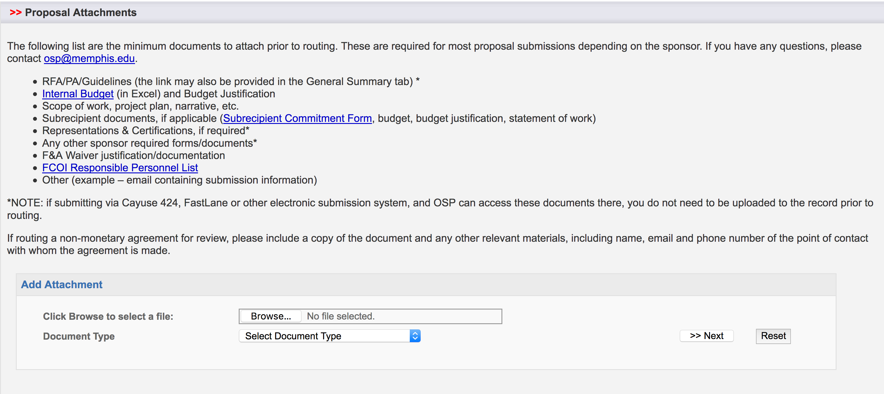
Proposal Submission – Best Practices

Slide 16
Proposal Submission – Best Practices
Submission methods
Email
Cayuse 424
External Systems
After the fact submission

Slide 18
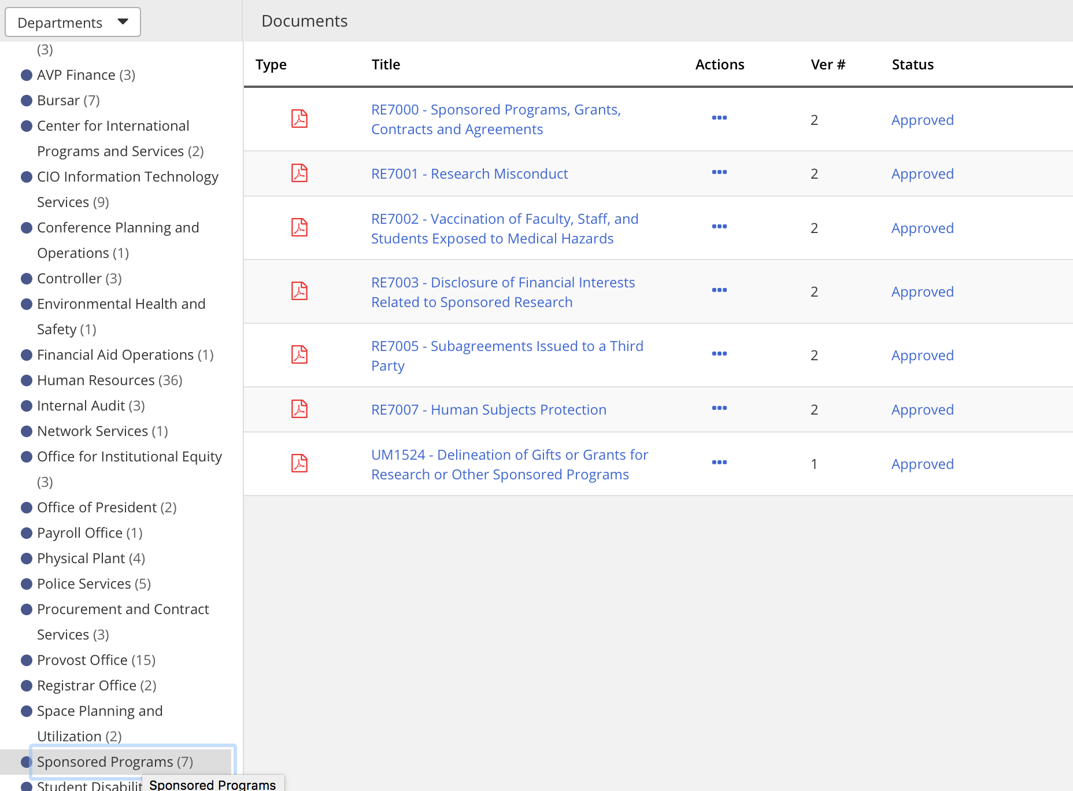
Research Policies

Slide 19
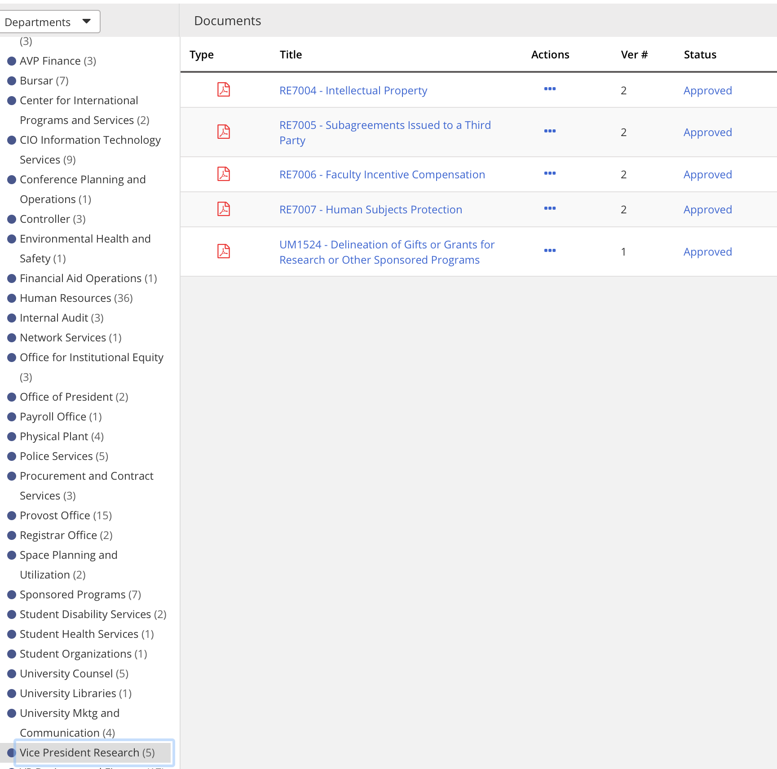

Slide 20
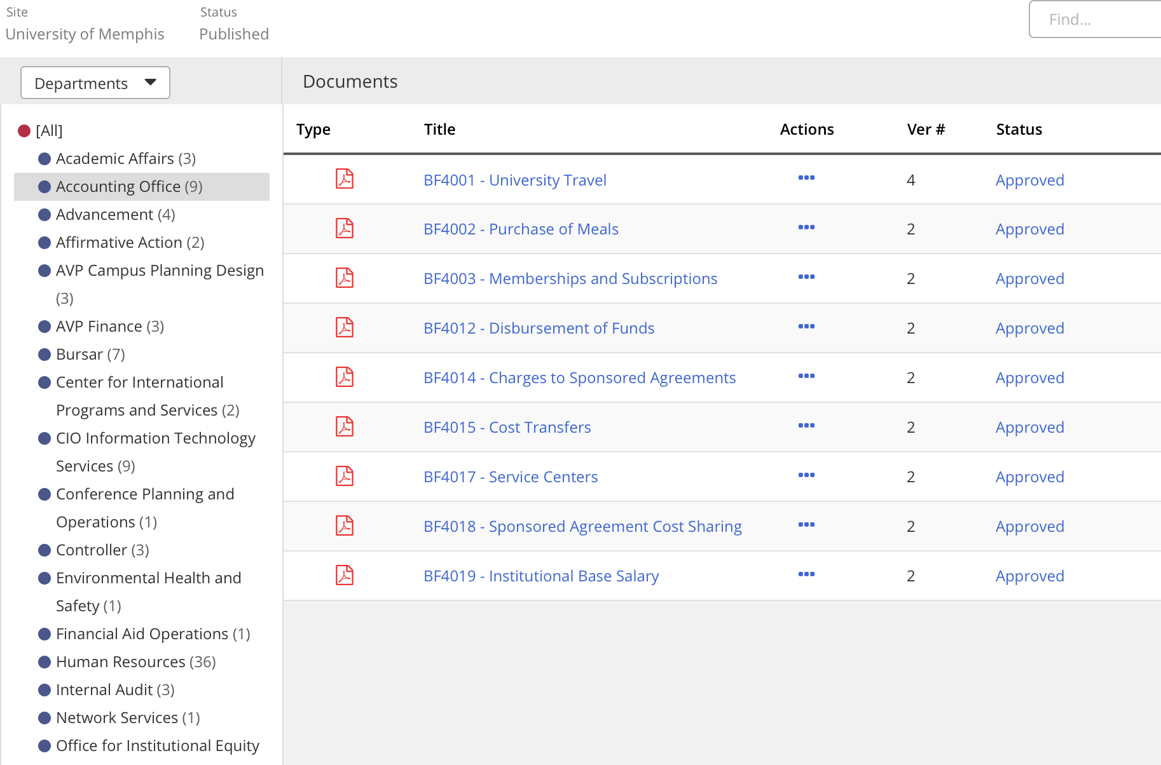

Slide 21
Join the VPR Listserv
Get timely information on topics related to research, compliance and/or sponsored project activity at the University.
Policies and Procedures affecting sponsored projects and research compliance (research, public service and training)
Electronic systems updates, outages and changes (including Cayuse IRB/424/SP)
Forums, learning opportunities and office closures
Send an email to: listserv@listserv.memphis.edu. Enter Subscribe RESADMIN-L in the body with no other text.

Slide 22
Research Administration
TRIVIA

Slide 23
Watch your
email for a survey!

