Slide 1
SLURM Headers
Brinton Eldridge
Graduate Assistant
Research Computing

Slide 2

Outline
What is SLURM?
Key Terminology
Cluster Structure
  Partitions
Building a Simple Job
SLURM Environment Vars
Quality of Life Headers
Commonly Confused/Misused Headers
Slurm Docs
(SchedMD)

Slide 3

What is SLURM?
Simple Linux Utility for Resource Management
It is a workload management software
  Responsible for scheduling, running, and limiting the resources of jobs.
This is the main way research starts on the cluster
Two methods:
  accompanied by a submission script
  accompanied by several flags
Submitting a Job
(uofmwiki)
sbatch
srun

Slide 4
Key Terminology
Partition
  A group of nodes with specific constraints (i.e., acomputeq or igpuq).
Node
  An individual compute machine in the cluster. Comprised of several CPU-cores.
CPU and CPU-core
  Technically 2 CPUs per each node, but each one is split into multiple cores.
  Intel nodes have 20 CPU-cores per CPU (40 for the whole node).
  AMD nodes have 96 CPU-cores per CPU (192 for the whole node).
Task
  A process or unit of execution in a job, which can be distributed across nodes or cores.

Slide 5
Partition
Node
CPU Core
CPU
CPU
#SBATCH --cpus-per-task=4
Memory
When requesting multiple CPUs, you’ll need to make sure the job you are running (perhaps in Python) is multi-threaded.
#SBATCH --nodes=1
#SBATCH --partition=acomputeq
You likely will not need to worry about requesting multiple nodes unless you are running in the awholeq/iwholeq.
Adding more than one partition as a comma-separated list will enable your job to queue to whichever one becomes available first.

Slide 6

Partition: acomputeq
Partition: awholeq
Partition: abigmemq

Slide 7

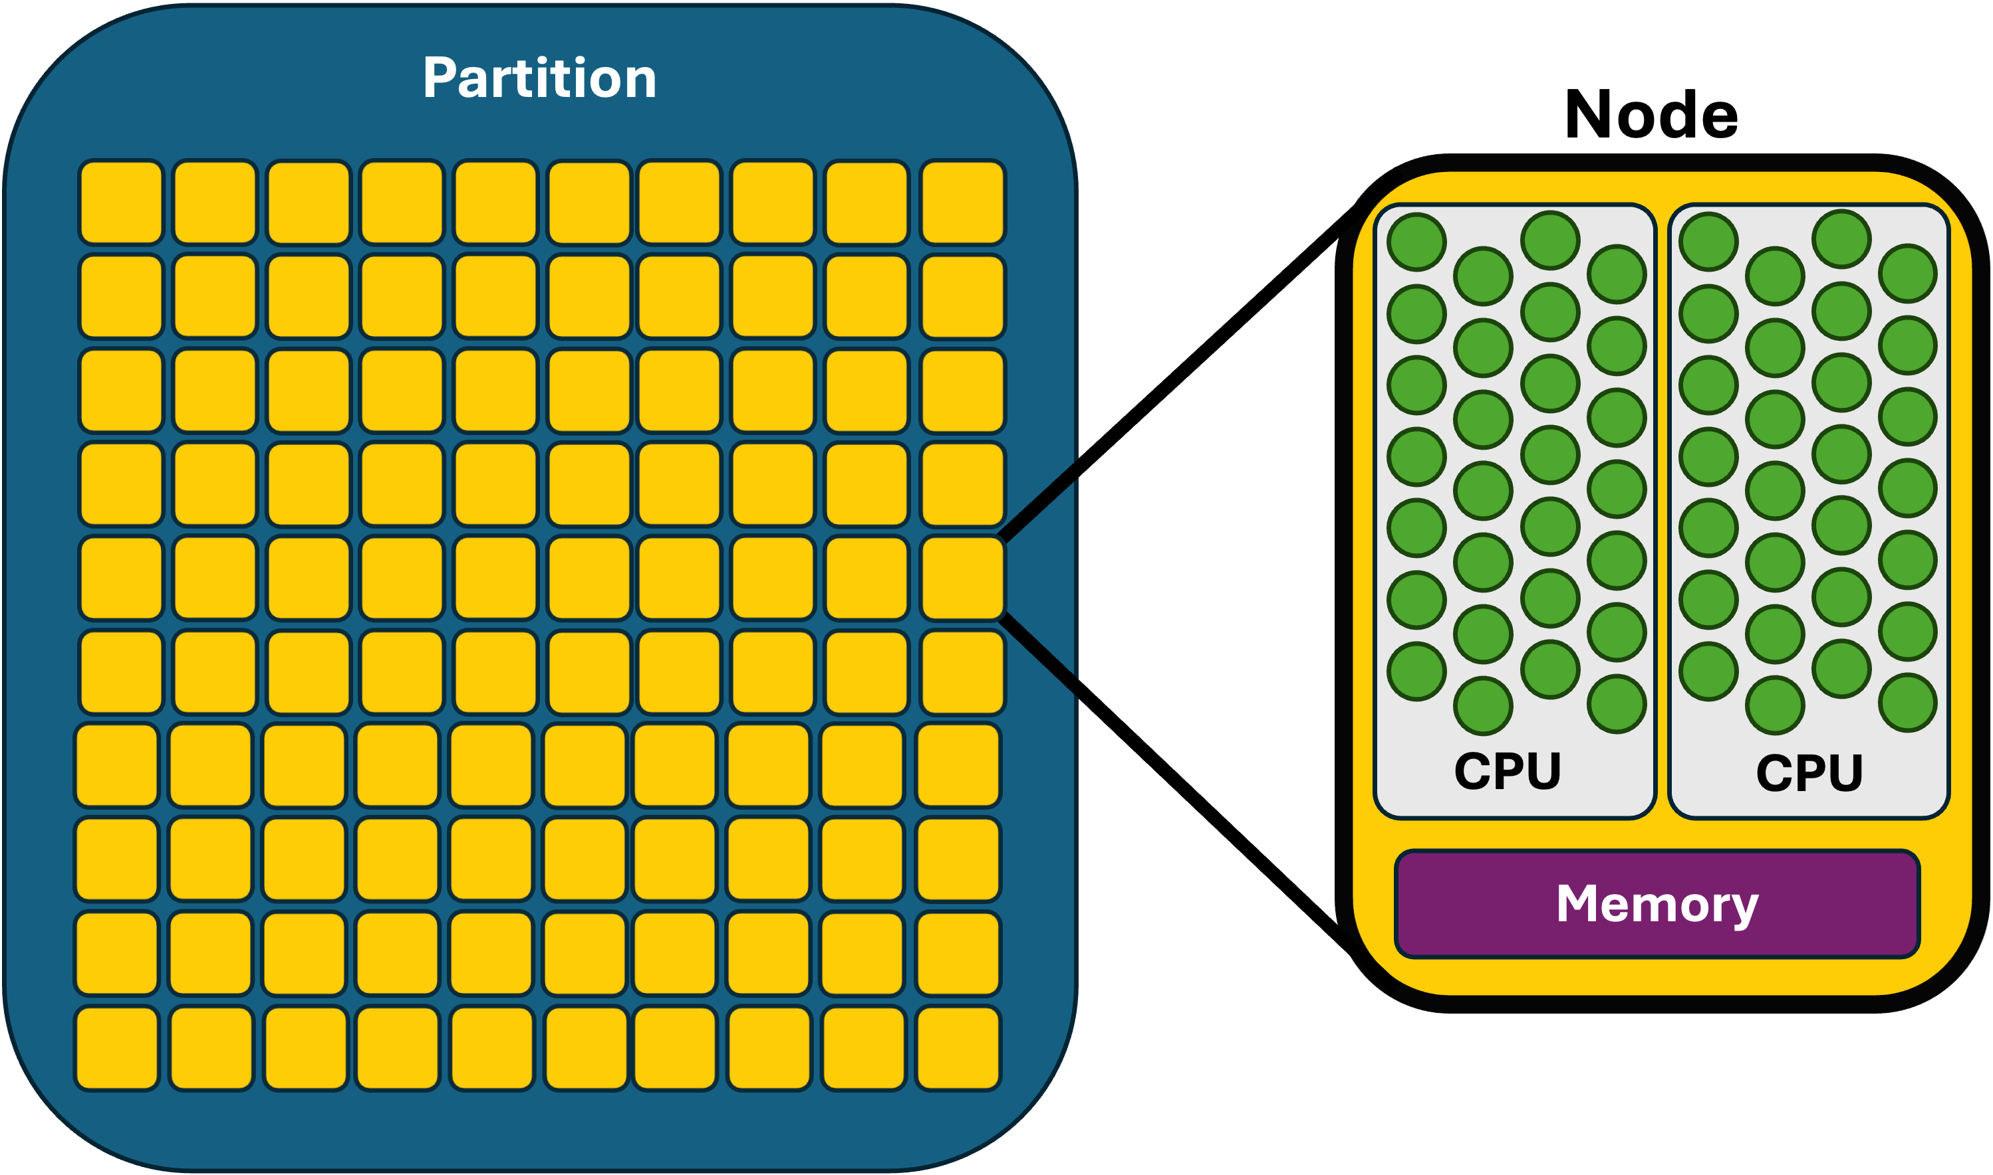
scontrol show partition
Partition | Nodes | Memory per Node | CPU Cores per Node | Additional Notes
acomputeq | 16 | 768 GB | 192
awholeq | 8 | 768 GB | 192 | Alloc cores in units of 192
abigmemq | 4 | 1.5 TB | 192
agpuq | 4 | 768 GB | 192 | 2 A100 GPUs
icomputeq | 40 | 192 GB | 40
iwholeq | 38 | 192 GB | 40 | Alloc cores in units of 40
ibigmemq | 4 | 1.5 TB | 40
igpuq | 6 | 192 GB | 40 | 2 V100 GPUs
Partitions (uofmwiki)

Slide 8

Let’s Build a Job
#!/bin/bash
#SBATCH --job-name=example1
#SBATCH --time=00:15:00
#SBATCH --mem=2G
#SBATCH --partition=acomputeq
module load spack
module load bwa
wget https://tinyurl.com/2z9y433r
mv 2z9y433r 2z9y433r.gz
gunzip 2z9y433r.gz
bwa index 2z9y433r
Necessary*
Typical
Slurm Example
(uofmwiki)

Slide 9
[bldrdge1@log02 example1 12\18\2025|10:41:36]↳ sbatch submit.sh
Submitted batch job 1946595
[bldrdge1@log02 example1 12\18\2025|10:41:38]↳ sacct -j 1946595 --format=JobID,JobName,Elapsed,TotalCPU
JobID JobName Elapsed TotalCPU
------------ ---------- ---------- ----------
1946595 example1 00:01:00 00:01.564
1946595.bat+ batch 00:01:00 00:01.563
1946595.ext+ extern 00:01:00 00:00:00
[bldrdge1@log02 example1 01\09\2026|11:42:56]↳ seff 1946595
Job ID: 1946595
Cluster: bigblue
User/Group: bldrdge1/users
State: COMPLETED (exit code 0)
Cores: 1
CPU Utilized: 00:00:02
CPU Efficiency: 3.33% of 00:01:00 core-walltime
Job Wall-clock time: 00:01:00
Memory Utilized: 11.07 MB
Memory Efficiency: 0.54% of 2.00 GB

Slide 10
SLURM Environment Variables
Variable Name | Description
SLURM_JOB_ID | The ID of the job allocation.
SLURM_JOB_NAME | The name of the job (from --job-name).
SLURM_JOB_NODELIST | List of nodes allocated to the job.
SLURM_JOB_NUM_NODES | Total number of nodes in the job allocation.
SLURM_JOB_CPUS_PER_NODE | Number of CPUs available per node (format: count[xnodes] for multiples).
SLURM_CPUS_PER_TASK | Number of CPUs requested per task (from --cpus-per-task).
SLURM_NTASKS | Total number of tasks in the job (from --ntasks).
SLURM_TASKS_PER_NODE | Number of tasks to be launched per node.
SLURM_MEM_PER_NODE | Memory allocated per node (from --mem).
SLURM_MEM_PER_CPU | Memory allocated per CPU (from --mem-per-cpu).
SLURM_GPUS_ON_NODE | Number of GPUs allocated on the current node.
SLURM_SUBMIT_DIR | The directory from which sbatch was invoked.
SLURM_ARRAY_TASK_ID | Job array index (if using job arrays).
SLURM_CLUSTER_NAME | Name of the cluster running the job.
SLURM_PROCID | The MPI rank or relative process ID for the current process.
SLURM_NODEID | The relative ID of the current node in the allocation (0-based).
#!/bin/bash
#SBATCH --job-name=example2
#SBATCH --time=00:05:00
#SBATCH --mem=2G
#SBATCH --partition=acomputeq
#SBATCH --cpus-per-task=2
python multi_sum.py $SLURM_CPUS_PER_TASK
Necessary*
Typical
Important for Example

Slide 11
#SBATCH --cpus-per-task=1
[bldrdge1@log02 example2 01\07\2026|14:43:47]↳ cat slurm-1982059.out
cpu-bind=MASK - ac01, task 0 0 [3327438]: mask 0x80000000000000000000000000000000 set
Total sum: 3464101623798.05
Execution time: 13.82 seconds with 1 processes
#SBATCH --cpus-per-task=2
[bldrdge1@log02 example2 01\07\2026|14:47:45]↳ cat slurm-1982060.out
cpu-bind=MASK - ac01, task 0 0 [3330018]: mask 0x80080000000000000000000000000000000 set
Total sum: 3464101623797.9116
Execution time: 6.77 seconds with 2 processes

Slide 12
Quality of Life
Pattern | Description
%A | Master job allocation ID (for job arrays).
%a | Job array task ID (index).
%J | Job ID followed by step ID (format: jobid.stepid).
%j | Job ID only (e.g., the numeric ID of the job).
%N | Short hostname of the first node (creates separate files per node if used).
%n | Node relative ID (0-based index within the job's nodes).
%s | Step ID of the job step.
%t | Task ID (rank) within the job (creates separate files per task).
%u | Username of the submitting user.
%x | Job name (from --job-name or the script name if unspecified).
#!/bin/bash
#SBATCH --job-name=example3
#SBATCH --time=00:05:00
#SBATCH --mem=2G
#SBATCH --partition=acomputeq
#SBATCH --cpus-per-task=2
#SBATCH --output=%x-%j.out
#SBATCH --mail-type=END,FAIL
#SBATCH --mail-user=bldrdge1@memphis.edu
python multi_sum.py $SLURM_CPUS_PER_TASK
Necessary*
Typical
Important for Example
QoL
Notes:
Notify user by email when certain event types occur. Valid type values are NONE, BEGIN, END, FAIL, REQUEUE, ALL (equivalent to BEGIN, END, FAIL, INVALID_DEPEND, REQUEUE, and STAGE_OUT), INVALID_DEPEND (dependency never satisfied), STAGE_OUT (burst buffer stage out and teardown completed), TIME_LIMIT, TIME_LIMIT_90 (reached 90 percent of time limit), TIME_LIMIT_80 (reached 80 percent of time limit), TIME_LIMIT_50 (reached 50 percent of time limit) and ARRAY_TASKS (send emails for each array task). Multiple type values may be specified in a comma separated list. NONE will suppress all event notifications, ignoring any other values specified. By default no email notifications are sent.

Slide 13
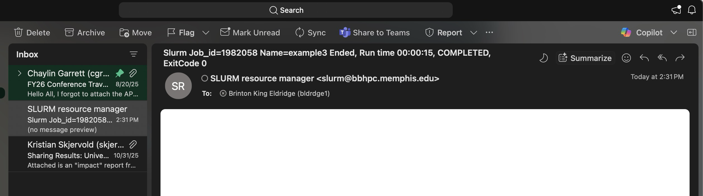



Typical:
[bldrdge1@log02 example2 01\07\2026|14:47:48]↳ ls
multi_sum.py slurm-1982059.out submit.sh
#SBATCH --output=%x-%j.out
[bldrdge1@log02 example3 01\07\2026|14:42:29]↳ ls
example3-1982058.out multi_sum.py submit.sh

Slide 14
Commonly Confused/Misused Headers
#!/bin/bash
#SBATCH --job-name=example4
#SBATCH --time=00:05:00
#SBATCH --mem=2G
#
# or
#
#SBATCH --mem-per-cpu=2G
#SBATCH --partition=acomputeq
#SBATCH --cpus-per-task=2
python multi_sum.py $SLURM_CPUS_PER_TASK
2GB of memory requested over the whole node, no matter how many CPUs the job accesses.
2GB of memory requested for each CPU accessed.
--mem = --mem-per-cpu * --cpus-per-task
though this is not the only way to request CPUs

Slide 15
Commonly Confused/Misused Headers
#!/bin/bash
#SBATCH --job-name=example4
#SBATCH --time=00:05:00
#SBATCH --mem-per-cpu=2G
#SBATCH --partition=acomputeq
#SBATCH --cpus-per-task=16
#
# or
#
#SBATCH --ntasks=4
#SBATCH --cpus=4
module load openmpi/4.1.6/gcc.8.5.0/mt
# python multi_sum.py $SLURM_CPUS_PER_TASK
mpirun -n $SLURM_NTASKS python multi_sum.py $SLURM_CPUS_PER_TASK
16 CPUs requested for a single task (because default tasks=1).
Task must be designed to accept multiple cores.
4 CPUs requested per task, 4 tasks running at once.
Job must be designed to utilize MPI (or similar) to make parallel tasks.
Tasks must be designed to accept multiple cores.

Slide 16
Commonly Confused/Misused Headers
#!/bin/bash
#SBATCH --job-name=example4
#SBATCH --time=00:05:00
#SBATCH --mem-per-cpu=2G
#SBATCH --partition=acomputeq
#SBATCH --cpus-per-task=16
#SBATCH --nodes=2
#SBATCH --ntasks-per-node=2
#
# or
#
#SBATCH --ntasks=4
#SBATCH --ntasks-per-node=2
...
2 different nodes requested, each planning on running two separate tasks.
4 total tasks being requested to be distributed across nodes, with two tasks per node, thus requesting 2 nodes.

Slide 17
Best Practices for Optimization
Test your Script: Submitting your submission file using
Match to Workload Type:
  For serial jobs, use 1 task/CPU/node.
  For parallel jobs, request multiple tasks to handle each process.
  For multithreaded processes, request multiple CPUs to be used in the process.
Add Buffers Wisely: 10-20% extra for memory/time to handle spikes, but not more—over-buffering blocks others.
Combine Parameters:
  for 8 tasks across 2 nodes, each with 2 CPUs.
  Avoid conflicts like using with .
Batch Short Jobs: Group small tasks into arrays ( ) or longer scripts to reduce scheduler load.
Common Pitfalls: Ignoring defaults (leads to surprises), not re-testing after code changes, or over-constraining.
sbatch --test-only submit.sh
--ntasks=8
--cpus-per-task=2
--nodes=2
--mem
--mem-per-cpu
--array
scontrol show partition
scontrol show config

Slide 18
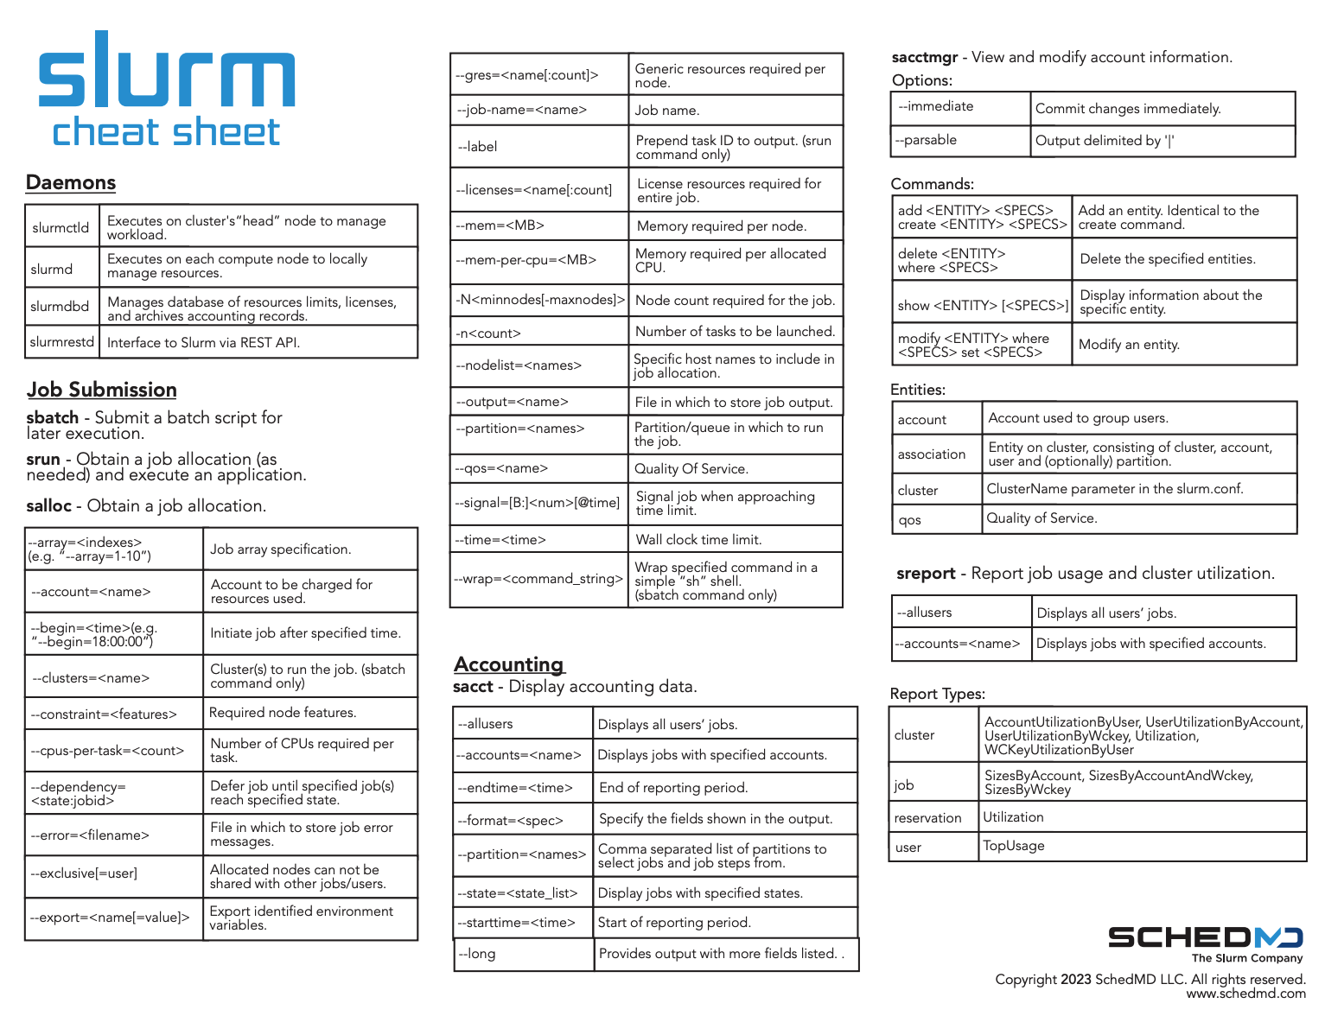

Slurm Cheat Sheet
(SchedMD)

