Slide 1


Public Health Design:
Problem Identification and Research
Innovating Solutions for Healthier Communities
Innovating Solutions for Healthier Communities
Notes:
Speaker Notes:
Welcome to our session on Public Health By Design
Today, we will explore how design principles can be applied to public health to develop, implement, and sustain innovative solutions.
We will cover key concepts such as problem identification, empathy and research, ideation, prototyping, testing and feedback, and implementation.
Let me take you through a structured approach to creating innovative and sustainable solutions for these challenges.

Slide 2
Intro to Public Health
Public health problems require innovative solutions that are both sustainable and effective. By applying a structured design process, we can create impactful interventions that address the root causes and consider the needs of diverse populations.
This workshop aims to introduce students to the design thinking process, guiding them from identifying a problem to creating an initial prototype.
Notes:
Speaker Notes:
What is public health? The CDC says its "Public health is the science of protecting and improving the health of people and their communities."
We will introduce students to the design thinking process and guide them from problem identification to ideation and cover concepts related to prototyping a solution.
Throughout this presentation, we will look at various examples and case studies to see how these concepts work in real-world scenarios.
In public health, the complexity of problems demands a thoughtful approach to design.
This presentation will outline a step-by-step process that integrates empathy, research, and iteration to develop solutions that are both innovative and practical.
Reference:
World Health Organization. (2019). Designing solutions for complex public health issues. Geneva: WHO Press.

Slide 3


Learning Objectives:
Understand how design can effectively address public health challenges.
Recognize the main stages in the design process for public health solutions for problem identification and research.
Learn to apply design thinking principles to create innovative public health interventions.
Grasp the importance of engaging stakeholders to ensure relevant and effective solutions.
Develop strategies to overcome common challenges in public health design.
. . . .
. . . . . . . .
. . . . . . . . . . .
. . . . . . . . . . . . . . .
. . . . . . . . . . . . . . . . . . .
. . . . . . . . . . . . . . . . . . . . . .
. . . . . . . . . . . . . . . . . . . . . . . . .
. . . . . . . . . . . . . . . . . . . . . . . . . . . . . .
. . . . . . . . . . . . . . . . . . . . . . . . . . . . . . . . .
Notes:
Speaker Notes:
Our learning objectives for today are to:
Understand how design can effectively address public health challenges.
Recognize the main stages in the design process for public health solutions.
Learn to apply design thinking principles to create innovative public health interventions.
Grasp the importance of engaging stakeholders to ensure relevant and effective solutions.
Develop strategies to overcome common challenges in public health design.

Slide 4
The Research Process
(WHO; Farrugia et al., 2010,;Kothari CR, 2009)
Define research problem
Workshop One
Literature review
Research question formulation
Defining Research hypothesis
Appropriate research design
Workshop Two
Collecting data
Data analysis & inference
Dissemination

Slide 5



Problem Identification & Framing
Empathy Mapping
Identifying and Framing the Problem
Defining a Problem Statement
Notes:
Speakers Notes:
The first step in any design process is to clearly define the problem.
This involves understanding who is affected, how they are affected, and the overall scale and impact of the issue.
A well-defined problem sets the foundation for effective solutions.
Reference:
Brown, T. (2009). Change by design: How design thinking creates new alternatives for business and society. HarperBusiness.

Slide 6

Identifying Public Health Problems
  Look for gaps in current healthcare services.
  Consider the needs of underserved populations.
  Use data to identify and prioritize issues.
Notes:
Speaker Notes:
The first step in developing a public health venture is identifying a specific problem.
Look for gaps in current healthcare services where needs are not being met.
Consider the unique needs of underserved populations who may lack access to traditional healthcare.
Use data to identify and prioritize the most pressing public health issues in your community.
Public health problems are defined as issues that adversely affect the health of communities. Common examples include infectious diseases like COVID-19, chronic conditions like diabetes, and environmental hazards such as pollution
Identifying public health needs involves assessing the health status of a population, often through community assessments and health data. Engaging with the community is crucial for gathering accurate data and building trust
References
World Health Organization. (2021). Health topics. Retrieved from WHO
Centers for Disease Control and Prevention. (2018). Community health assessment. Retrieved from CDC

Slide 7
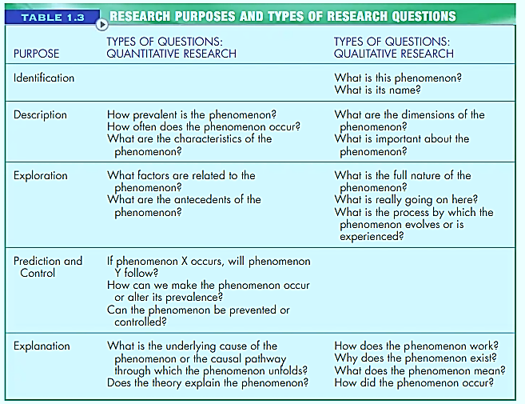
Examples of a Research Question
Notes:
An interrogative statement of inquiry. Interest will give rise to research idea, but in depth knowledge is needed to develop a research question
In addition, awareness of current trends and technological advances can assist with the development of research questions.²It is imperative to understand what has been studied about a topic to date in order to further the knowledge that has been previously gathered on a topic. Indeed, some granting institutions (e.g., Canadian Institute for Health Research) encourage applicants to conduct a systematic review of the available evidence if a recent review does not already exist and preferably a pilot or feasibility study before applying for a grant for a full trial.
Interest in the area of study. Is this research question significant, given the existing base of knowledge?
Could findings from this research be useful in clinical practice?
And methodologic issues (How can this question best be studied to yield high-quality evidence?)

Slide 8
The FINER Criteria
(Hulley & Colleagues,2007)
FEASIBLE
Adequacy
Affordability
Manageability
F
RESEARCH
QUESTION
INTERESTING
Thought provoking answers
RELEVANT
To scientific knowledge
To policies
To future research
R
I
ETHICAL
Clear ethical review procedures
NOVEL
Validate
Supplement
Add
E
N
Farrugia et al., 2010
Notes:
FINER criteria for a good research question
FFeasibleAdequate number of subjects
Adequate technical expertise
Affordable in time and money, given the resources and constraints
Manageable in scope- not too broad
IInterestingGetting the answer intrigues investigator, peers and community
NNovelConfirms, refutes or extends previous findings
EEthicalAmenable to a study that institutional review board will approve
RRelevantTo scientific knowledge
To clinical and health policy
To future research
Hulley S, Cummings S, Browner W, et al. Designing clinical research. 3rd ed. Philadelphia (PA): Lippincott Williams and Wilkins; 2007.
Ethical: Social or scientific value
Scientific validity – apply accepted scientific principles and methods to produce reliable and valid data
Fair subject selection – distribute burdens and benefits equitably (i.e., not targeting vulnerable individuals for risky research while favoring the rich for beneficial research)
Favorable risk-benefit ratio – risks to subjects are minimized, and are proportionate to anticipated benefits and knowledge
Independent review – monitor data to ensure subjects’ safety and provide public accountability
Informed consent can be obtained (or is not needed)
Respect for autonomy – permit patient withdrawal, protect patient confidentiality, inform subjects of results, monitor welfare of subjects
Researchable

Slide 9
Formulation of Research Question
Research Idea
Broad
Reading
brainstorming/ guidance
Observation
Practical experiences
Interest
Zeroing in on research idea
FLEXIBILITY
Literature Review
Identify components of RQ
Draft, Revise, Refine
Narrow/ focused
RQ
(WHO; Haber J., 2010)
Notes:
(1) Relying on one’s own clinical experience or practice;
(2) discussing issues with other researchers at professional meetings;
(3) following developments in the literature and identifying gaps in the literature;
(4) discussing issues with a mentor;
(5) being alert to new ideas and technological advances;
(6) brainstorming with friends and colleagues;
(7) keeping the imagination roaming;
(8) searching information about the national and global
burden of disease; and
(9) using focus groups.

Slide 10
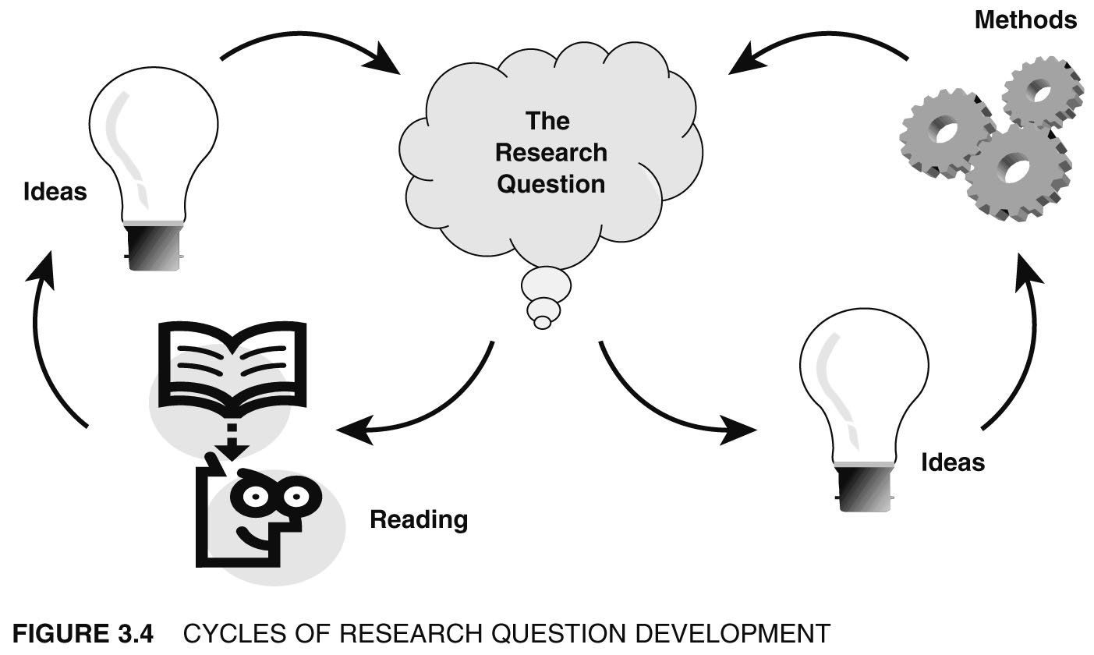
Step 1: Research Idea
O'Leary, Z. (2004) The Essential Guide to Doing Research. London: Sage. Chapter Three
Notes:
Not a linear process:
Sometimes your question seems doable at first but when you begin your research, it turns out not to be the case. Because most often you are doing a literature search for the results of previous research (as opposed to original research), it is recommended that you do a preliminary search to test if you can get enough material, and then, if necessary, revise your question.

Slide 11

Identify Components of Research Question
A good research question describes always
        POPULATION
        INTERVENTION
        COMPARISON
        OUTCOME
        TIME FRAME
PICO format introduced in 1995, later expanded to PICOT
(Richardson et al., 1995)
(Haynes RB et al., 2006)
Notes:
Broadly, well developed Research Question components = Population + Variables + Testability
(Haynes BR, 2006; Riva J., 2012; WHO; Haber J., 2010; Farrugia et al., 2010)
PPopulation (patients)What specific patient population are you interested in?
IIntervention (for intervention studies only)What is your investigational intervention?
CComparison groupWhat is the main alternative to compare with the intervention?
OOutcome of interestWhat do you intend to accomplish, measure, improve or affect?
TTimeWhat is the appropriate follow-up time to assess outcome
Brian Haynes R. Forming research questions. J Clin Epidemiol. 2006;59:881–6.

Slide 12
POPULATION / PATIENT:
“What specific patient population are you interested in?”
    ‘Target group’ or ‘participants / respondents’ on whom study is planned
    Represent the sample subjects to be recruited for study
    Rational and ethical justification should drive their consideration
e.g.: Age, gender, ethnicity, duration of illness
Farrugia et al., 2010
(Haynes BR, 2006; Haber J., 2010; Riva et al., 2012)
Notes:
or ex-ample, we might specify nurses (RNs) and residence in the United States as attributes of interest; the study population would then consist of all li-censed RNs who reside in the United States. We could in a similar fashion define a population con-sisting of all children younger than 10 years of age with muscular dystrophy in Canada, or all the change-of-shift reports for the year 2002 in Massachusett
Population of interest should be defined properly, i.e inclusion and exclusion criteria explicitly stated
This helps proper interpretation and subsequent applicability and generalizability of the research findings: General Hospital

Slide 13
  INTERVENTION / INDICATOR/ EXPOSURE
“What is the exposure or investigational intervention?”
    Refers to the treatment that will be provided to subjects enrolled in your study or
    The exposure/ risk factor being measured for a disease or condition
E.g.: type, dosage and duration of intervention, exposure or risk factor measured
Farrugia et al., 2010
(Haynes BR, 2006; Haber J., 2010; Riva et al., 2012)

Slide 14
  3. COMPARISON/ CONTROL
“What is the main alternative to compare with the intervention?”
  - What will be the comparison group and its characteristics?
  (e.g.: patients without diabetes, patients who receive only placebo, subjects without a particular risk factor)
  - What will be the alternative treatment, i.e to what is the intervention being compared? (e.g.: placebo, other active treatment/ strategy depending on risks)
Farrugia et al., 2010
(Haynes BR, 2006; Haber J., 2010; Riva et al., 2012)

Slide 15
  4. OUTCOME(S)
“What do you intend to accomplish, measure, improve or affect?”
    The endpoint (primary and secondary) and its measures
E.g.: Frequency, risk, benefit, harm
Measurement: dichotomous or continuous
Type: mortality, morbidity, quality of life, etc.
Farrugia et al., 2010
(Haynes BR, 2006; Haber J., 2010; Riva et al., 2012)

Slide 16
Desired Properties of Primary Outcomes
Fit for study objectives
Appropriate
Objective
Valid
Reproducible/ precise/reliable
Clinically available
Easily quantifiable
Efficient
Sensitive
Specific
Responsive
Straight-forward
Always allow interpretation of results
Require less subjective judgment to measure
Should sensitive to changes in treatment
Measure which is intended
Good
Primary
Outcome
Should correctly absence of disease/ condition of interest
Easily be reproduced in different times/ settings
Should correctly presence of disease/ condition of interest
Be available as part of clinical care
Be affordable to measure in terms of time and cost
Be easily measured
Table 3: Desired Properties of Primary Outcomes. Thomas, T., & Paul, J. (2009). Posing the research question: not so simple. Canadian Journal of Anaesthesia 56(1), 71-79

Slide 17
  5. TIME FRAME
“What is the appropriate follow-up time to assess outcome?”
  The time frame or duration over which the study will take place
  If it is one time study at a particular point or period
  (e.g. a study to measure prevalence of a disease)
  If follow up required; how many and at what time points
  (e.g.: when and how many times blood sugar will be measured for an new type of treatment intervention)
Farrugia et al., 2010
(Haynes BR, 2006; Haber J., 2010; Riva et al., 2012)

Slide 18
Your Turn
Throughout the process, assess the research question’s significance and feasibility
Explicit identification and description of variables and their measurement is important for testability
Framing an explicit research question offers a common language between clinician & researcher discourse
Framed question such that it is easily understood and can be rephrased in the reader’s own words.
(Haber J., 2010)
(Farrugia et al., 2010)
(Beyea, 1997; Gaberson, 1997)
Notes:
Framing of a research question offers a common
language between clinician and researcher
discourse

Slide 19

Stakeholder Engagement
Engage community members, health professionals, and other stakeholders
Gather insights to ensure relevance and cultural sensitivity
Facilitate inclusive participation
Notes:
Speaker’s Notes:
Engaging stakeholders early in the process is critical.
By involving those who are directly affected, as well as professionals with expertise, we can gather valuable insights.
This approach ensures that the solution is relevant, culturally sensitive, and supported by the community.
Circles of Identity to Check Personal Bias
Cluster and Stakeholder Mapping
Reference:
Freire, K., & Sangiorgi, D. (2010). Service design and healthcare innovation: From consumption to co-production and co-creation. Design Studies, 31(2), 99-118.

Slide 20

Conducting Research and Gathering Data
  Use qualitative and quantitative research methods.
  Collect data from reliable sources.
  Analyze data to understand the problem and potential solutions.
Notes:
Speaker Notes:
Conducting research and gathering data is crucial for understanding the problem and developing effective solutions.
Use a combination of qualitative methods, like interviews and focus groups, and quantitative methods, like surveys and statistical analysis.
Collect data from reliable sources, such as academic journals, government reports, and community organizations.
Analyze the data to gain a deep understanding of the problem and identify potential solutions.
Research and analysis are essential to understand the problem deeply.
This includes both qualitative methods, like interviews and focus groups, and quantitative data analysis.
Reviewing existing interventions helps identify what works and where there are gaps.
Equip students with basic research skills and insights to inform their solutions.
Pay attention to Activities, Environments, Interventions, Objects, and Users – A, E, I, O, U’s
Activities:
Research Techniques Overview: Introduce basic research methods such as surveys, interviews, and observations. Provide examples and templates for each.
Group Research Activity: Assign each group a research method to gather information about their problem. Encourage them to use online resources or interviews with peers.
Sharing Insights: Have each group present their findings and discuss how these insights influence their understanding of the problem.
Reference:
Sanders, E. B.-N., & Stappers, P. J. (2014). Probes, toolkits and prototypes: Three approaches to making in codesigning. CoDesign, 10(1), 5-14.
Johnson, A., Smith, B., & Brown, C. (2017). Research methods in public health. Journal of Public Health, 34(2), 123-134.Smith, D. (2019).
Analyzing public health data. Health Data Journal, 29(3), 145-156.
Patton, M. Q. (2015). Qualitative research & evaluation methods. Thousand Oaks, CA: SAGE.

Slide 21
Interview Guide:
Intro
Purpose
Outline of the Interview
Assurance of participant’s expertise in their own lived experiences
Kick-Off
Get the participant started
Introduction and transition to questions
Build Rapport
Encourage stories about daily lived experiences, routines, life
Find out what’s important to participant
Grand Tour
Explore details about how the participant goes about doing things
Physical and mental – the what and how of the things they do
Activities, objects, environments observed
Reflection
Ask why participant does things the way they do and how has that changed over time, if at all
Ask about the participant’s hopes, dreams, aspirations and what they’d like to see happen in the future as related to the topic
Wrap Up
Thank you and ask about any final thoughts

Slide 22
Sample Interview Set Up Questions
Creating an interview guide for research involves structuring questions to gather the most relevant data while ensuring the conversation flows naturally. Here's a guide to help you design an effective interview guide:​
1. Introduction​
Purpose Statement:​
  Briefly explain the research's purpose and goals.​
  Example: "Thank you for taking the time to speak with me today. We're conducting research to understand [topic] better. Your insights will help us [specific outcome]."​
Confidentiality Assurance:​
  Explain how the data will be used and ensure the participant's confidentiality.​
  Example: "Your responses will be kept confidential, and we'll use the information solely for research purposes."​
Consent:​
  Ensure that the participant has provided consent to participate and record the interview if applicable.​
  Example: "Do we have your permission to record this interview for accuracy?"​
2. Warm-Up Questions​
Icebreakers:​
  Begin with general questions to make the participant comfortable.​
  Example: "Can you tell me a little about your background and how you became involved with [topic]?"​
3. Core Questions​
Open-Ended Questions:​
  Design broad questions that allow the participant to elaborate.​
  Example: "What has been your experience with [specific aspect of the topic]?"​
Probing Questions:​
  Follow-up on responses to get deeper insights.​
  Example: "Can you explain further why you feel that way?" or "Could you provide an example?"​
Specific Questions:​
  Ask more focused questions on key areas of interest.​
  Example: "How do you think [specific factor] influences [specific outcome]?"​

Slide 23
Sample Interview Set Up Questions
4. Hypothetical or Scenario-Based Questions​
Explore Potential Situations:​
  Ask the participant to respond to a hypothetical scenario related to the research.​
  Example: "If you were in charge of [related task or policy], how would you approach it?"​
5. Reflective and Comparative Questions​
Encourage Reflection:​
  Ask participants to compare experiences or reflect on changes.​
  Example: "How has your perspective on [topic] changed over time?" or "How does this compare with your experience in [related context]?"​
6. Closing Questions​
Final Thoughts:​
  Provide the opportunity for any additional comments.​
  Example: "Is there anything we haven’t discussed that you think is important to mention?"​
Summarize:​
  Recap key points and confirm understanding.​
  Example: "Just to summarize, you've mentioned [key points], is that correct?"​
Next Steps:​
  Explain what happens next in the research process.​
  Example: "We'll analyze the data over the next few weeks. If you’re interested, we can share our findings with you once the research is complete."​
7. Post-Interview Notes​
Immediate Documentation:​
  Note any non-verbal cues, the interview environment, and any initial thoughts or observations.​
Tips for an Effective Interview Guide:​
  Be Flexible: Allow room to explore unexpected areas that arise during the interview.​
  Pilot Test: Test the guide with a colleague or in a practice interview to refine questions.​
  Balance Structure and Flexibility: Ensure you cover all key topics while being open to following the participant’s lead.​
This guide can be adapted based on the specific context and goals of your research.​

Slide 24

Next Workshop:
Ideation and Storyboarding
Jan. 21
Thank You!

